Slide 1

ANN MINI PROJECT

Slide 2
TEAM COMPOSITION
M P PRAMUK | PES1UG20EC321
MADHAV V K | PES1UG20EC309
POORVI RADDI | PES1UG20EC318
NIHARIKA C | PES1UG20EC315
Guide : Karpagavalli S (ECE)

Slide 3
CONTENTS
Introduction
Problem Statement
Literature Survey
Methodology /Motivation
Block Diagram
Working Principle
Deliverables
Project timeline Gantt Chart

Slide 4
INTRODUCTION
Default is the failure to make required interest or principal repayments on a debt, whether that debt is a loan or a security.
Defaults can occur on secured debt, such as a mortgage loan secured by a house, or unsecured debt, such as credit cards or a student loan.
Defaults expose borrowers to legal claims and may limit their future access to credit.

Slide 5
PROBLEM STATEMENT
Artificial neural networks employed to help financial institutions predict if users are capable of paying their loans or will they default.
The goal of this project is to build a model that can predict if a person will default on the loan based on the loan and personal information provided.
The model is intended to be used as a reference tool for financial institutions to help make decisions on issuing loans, so that the risk can be lowered, and the profit can be maximized.

Slide 6
Methodology
Data Analysis
Data Preprocessing
Outliers Detection
Feature Selection
Splitting dataset to training data and testing data
Model Building
Model evaluation

Slide 7
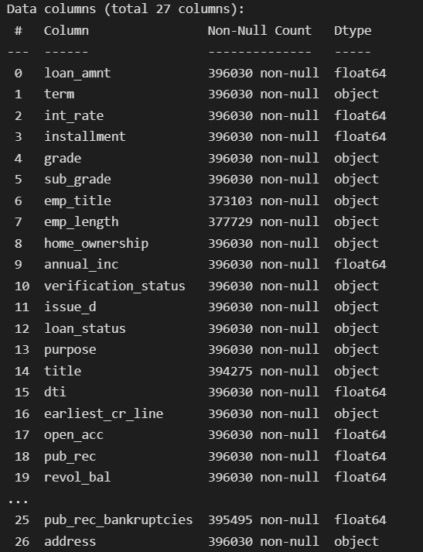
Data Analysis
Dataset Used: Lending Club Dataset
Features: 27
Rows - 396030
Target Variable - Loan Status
Loan Status: Fully Paid/ Charged Off

Slide 8
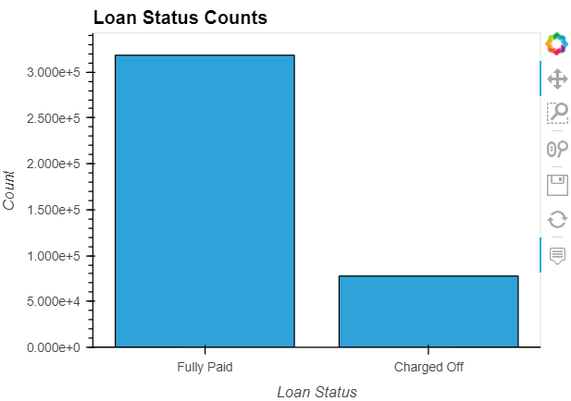
Fully Paid - 318357
Charged Off - 77673 (18%)

Slide 9
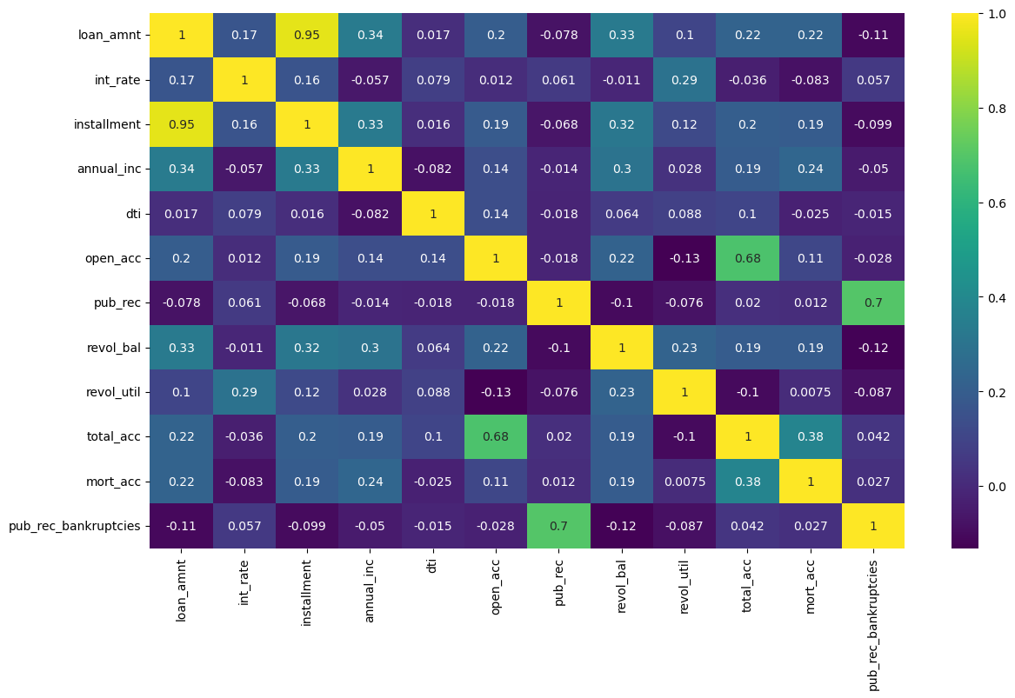
Data Analysis
To understand which features are important
Main Correlations:
Loan amount and installment
Annual income and loan amount
loan amt and revolving balance
Open credit Lines and total credit lines, etc
possible correlations range is from +1 to –1, where:
Zero correlation indicates that there is no relationship between the variables.
A correlation of –1 indicates a perfect negative correlation, meaning that as one variable goes up, the other goes down.
A correlation of +1 indicates a perfect positive correlation, meaning that both variables move in the same direction together.

Slide 10
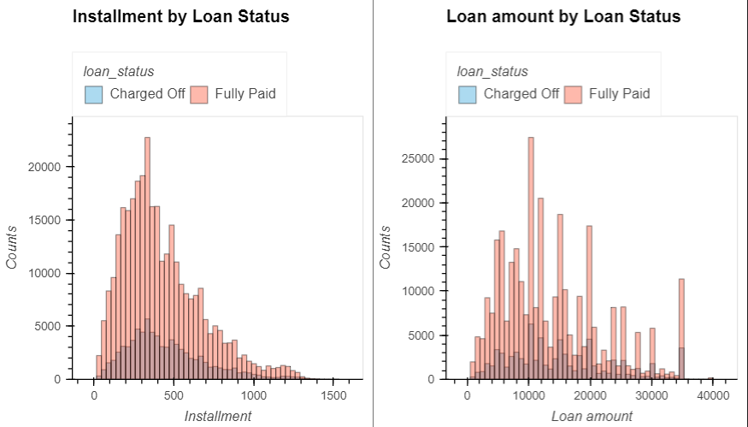
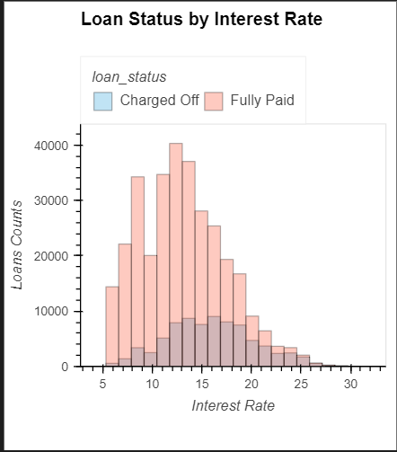
Comparison of Features with Target Variable

Slide 11
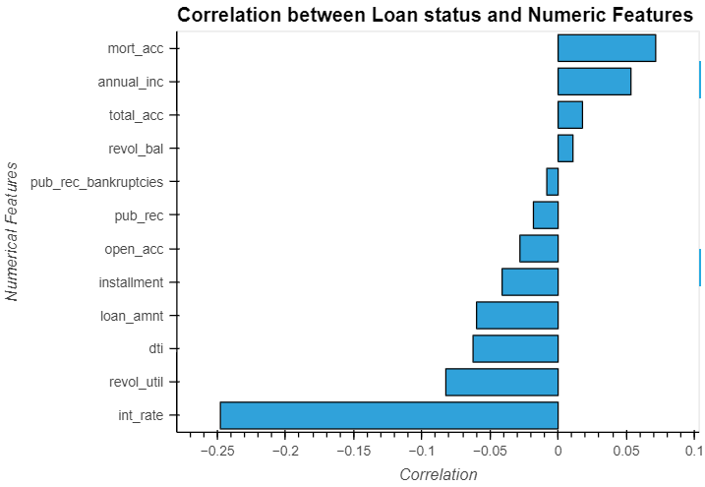

Slide 12
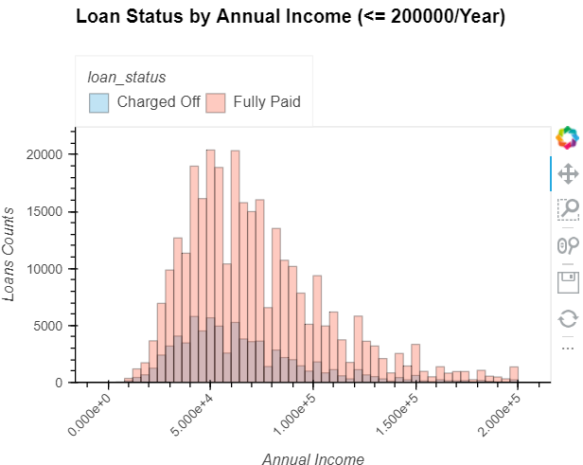
Observations:
As interest rates increases the percentage of fully paid decreases and majority are charged off.
People with lower annual income seems to not pay back their loans
‘F’ and ‘G’ subgrades don't get paid back that often.
Only 75 borrowers have an annual income more than 1 million, and 4077 have income greater than 250k
It seems that the smaller the ‘dti’ the more likely that the loan will not be paid.
Only 277 borrower have more than 40 open credit lines.
Only 266 borrower have more than 80 credit line in the borrower credit file.

Slide 13
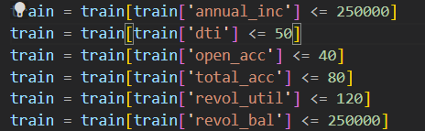
Outlier Detection
Outliers are nothing but data points or observations that fall outside of an expected distribution or pattern
For certain features we considered only values which had high counts and discarded remaining to avoid overfitting of the model.

Slide 14
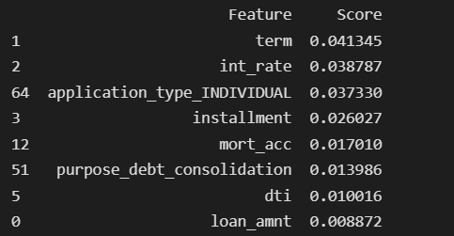
Feature Selection
Algorithm Used : Mutual Info Classif
This method basically utilize the mutual information. It calculates mutual information value for each of independent variables with respect to dependent variable, and selects the ones which has most information gain. In other words, it basically measures the dependency of features with the target value. The higher score means more dependent variables.
Discarded Features:
title
grade
Address
Loan issue date
Zip Code
Employee title
Employee Work Duration

Slide 15
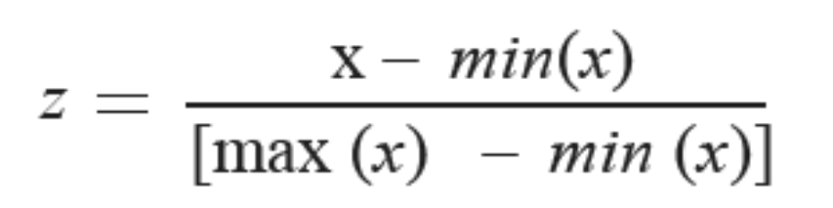
Normalise Data and Dataset Split
Normalization scales each input variable separately to the range 0-1.
We have used minmaxscaler from sklearn.preprocessing for normalization
Dataset is split into training and testing.
Training Data: 67%
Testing Data: 33%
We have sklearn.model_selection train_test_split to carry out the above operation

Slide 16
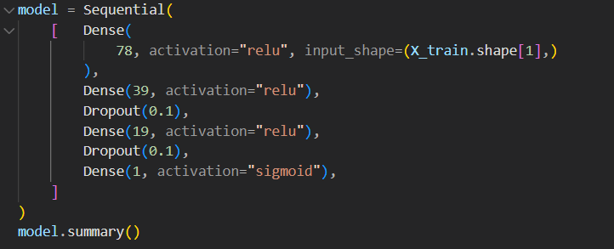
Neural Model

Slide 17
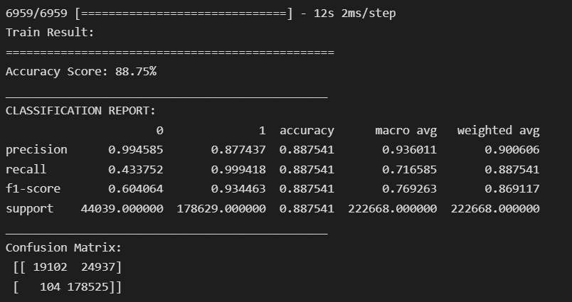
RESULTS
TRAINING RESULTS

Slide 18
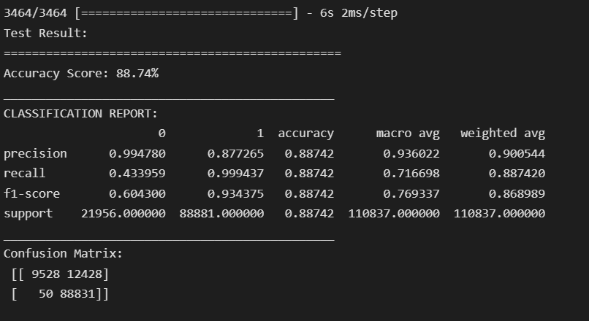
TESTING RESULTS

Slide 19
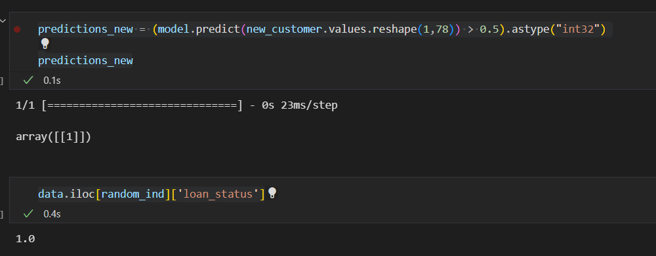
Prediction with custom inputs

Slide 20
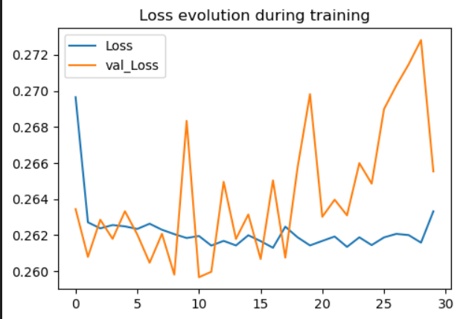
Depiction of loss during training and validation

Slide 21
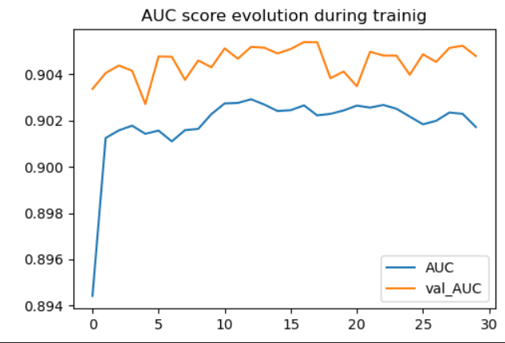
AUC score

Slide 22
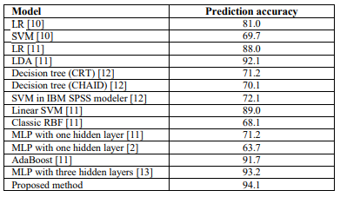
Comparison with Literature Survey
Majority of research papers have trained the data using inbuilt classifiers whereas we created our own ANN model. The accuracy of our model is around 89% which is equivalent to many inbuilt classifier models and better than self created neural models.

Slide 23
2. We have used mutual_info_classif to extract features. During survey we found that few of them have used Principal Component Analysis. The performance of our model is similar to their model.

Slide 24
THANK YOU

Slide 25
LITERATURE SURVEY
Several studies on default prediction have been done, and below are a few reviews.
Research papers and websites we have referred for this particular problem statements are:
Loan Default Predictive Analytics - https://ieeexplore.ieee.org/stamp/stamp.jsp?tp=&arnumber=9848906
https://medium.com/@ruinian/an-introduction-to-adasyn-with-code-1383a5ece7aa
https://ieeexplore.ieee.org/document/8944605
https://www.irjet.in/archives/V5/i4/IRJET-V5I4942.pdf

Slide 26
[1] Loan Default Predictive Analytics
2022 IEEE World Conference on Applied Intelligence and Computing
Authors : Ebenezer Owusu, Richard Quainoo, Justice Kwame Appati, Solomon Mensah* - University of Ghana
Topics covered : Loan-default, Imbalanced dataset, Adaptive synthetic sampling (ADASYN), Neural network (NN)
Methodology :
Dataset used : Loan statistics from lending club, an online P2P firm.
Data contains 74 columns and 887371 rows. Features – Int. Rate, employed, Salary, etc
The loan status which is a categorical data type that has been categorized into two primary categories, “Default” and “Fully Paid.”
Data pre-processing: data was cleaned by removing NaN values and appropriate features were extracted relevant to the problem statement.
Balancing of imbalanced data set:
Unlike other approaches where they have used oversampling or under sampling, the authors have used ADASYN approach to handle imbalanced data set.
This approach introduced synthetic data for the minority data set which helped in improving the accuracy of the model
The top four characteristics with the greatest score were chosen for usage. The chosen features, were grouped and assigned to the variable (x) representing the independent variables, to aid in the prediction of the dependent variable (y) which is the loan status

Slide 27
NN architecture was used to predict the outcome.
The chosen optimizer for this function is the Adam stochastic gradient descent algorithm
Forward propagation is used to activate neurons in such a way that their activity is constrained by weights. The activations are repeated until the expected outcomes y are obtained.
Error is calculated and weights are updated according to the error
The output of this method resulted in a model with an accuracy score of 0.92
Results:
The prediction accuracy of 94.1% is obtained. This performance is the highest score across multiple experiments with different batch sizes and epochs. The findings clearly demonstrate that the proposed technique is very promising.
Conclusion:
The ADASYN minority oversampling technique produced better, less biased prediction results that were visible after the forecast was made.
The findings show that the proposed method is successful in enhancing the accuracy of loan default prediction

Slide 28

[2] Identification of Potential Future Credit Card Defaulters
2019 10th International Conference on Computing, Communication and Networking Technologies (ICCCNT)
Authors: Ujjawal Kamal Panchal – SRM IT, Sanjay Verma – IIM Ahmedabad
Topics covered : Loan-default, Imbalanced dataset, Self-Organizing Maps
Methodology :
Dataset used :
The selected dataset contains 15,000 rows and 24 columns
Columns contain features like ‘Card type’, ‘Branch status’, etc.
Data pre-processing:
Each data point has a unique Index number which can be used to recognize them individually.
All features used for prediction are min-max normalized. Min-max normalization or min-max scaling is a method used to rescale the range of features to range of [0,1].
The formula for calculating the resultant is given in equation below

Slide 29
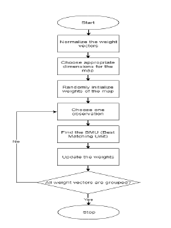
Self-Organizing Maps:
Self-organizing maps are unsupervised artificial neural networks which produces a low dimensional discrete representation of the input space of data samples, called a map.
The above formula is used to find the number of neurons from the number of training examples.
The self-organizing map is a two-dimensional network of neurons. Unlike some other types of neural networks which learn by error correction, they learn on the basis of competition for representation.
Training, Optimization and Testing:
The pre-processed dataset , is split into training set which constitutes 80% of the whole dataset, cross validation set which comprises of 10% of the whole and test set which comprises of the remaining 10% of the dataset.
The hyperparameters, initial learning rate () and spread of the neighborhood gaussian function () are found. The self-organizing map of 625 neurons is trained on the training set.
Conclusion:
In this paper, we use the self-organizing maps, which is a type of unsupervised artificial neural network to identify potential future credit card defaulters who haven’t yet defaulted from a dataset containing past defaulters and non-defaulters.
Self-organizing maps are suitable for dimensionality reduction. Data clustered together have similar properties and characteristics. Thus, based on LPV (limit percentage value) we can find the possible future defaulters from these clusters.

Slide 30
[3] Neural Network Approach to Loan Default Prediction
2018 International Research Journal of Engineering and Technology (IRJET)
Authors: Manjeet Kumar, Vishesh Goel, Tarun Jain, Sahil Singhal, Dr. Lalit Mohan Goel
Topics Covered: Loan Default, Imbalanced Dataset, Multilayer perceptron, PCA
Methodology:
It contains a total of 9578 rows with 14 original columns converted to 19 with dummy columns for the “loan_purpose” attribute.
After preparation of dataset, the data was divided into testing and training set. 90% data was used to train the model and the rest 10% to test it.
Multilayer Perceptron model of Deep Neural Network is used because of its ability to create non-linear model based on predicting variables provided to the model as inputs.
With reduced dimensions using PCA, the number of inputs provided to Deep Neural Network are reduced and 18 inputs have been provided to the model. These 18 inputs are provided to 18 perceptron of the input layer or first layer of the model which are non-linearly activated using sigmoid function.
There are 2 such hidden layers which contain 20 perceptron each which are also connected to their immediate next layers.
The last hidden layer is connected to output layer and output layer provides the final output. During training of model this output is used to calculate the connection weight which was randomly assigned initially.

Slide 31
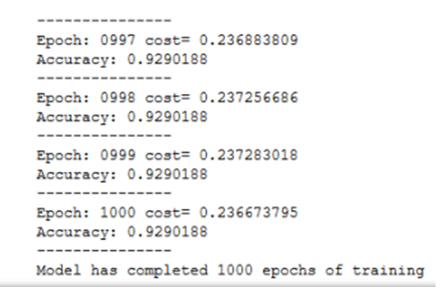
The last hidden layer is connected to output layer and output layer provides the final output. During training of model this output is used to calculate the connection weight which was randomly assigned initially.
Metrics: Finally, we studied the model and its capability with the help of performance metrics.
RESULTS
We were able to achieve an accuracy of around 90.1% which is fairly accurate for such a large dataset. The model is implemented using a multilayer perceptron with 2 hidden layers of 20 nodes each and it has been trained for 1000 epochs.
CONCLUSION:
Loan default prediction is done using the Multilayer Perceptron Model with Adam Optimizer as the optimization function. the proposed neural network model is tested for effectiveness using dataset provided by the Lending club bank.
LIMITATION:
For the neural network model, its accuracy rate within the regular cut off has already reached the mark of 93% and the dataset used is imbalance. The accuracy and precision of the model can further increase if we increase the number of hidden layers as well as the number of perceptron in each layer within a certain threshold value.

Slide 32
[4] Loan Default Prediction Using Diversified Sensitivity Undersampling
2018 International Conference on Machine Learning and Cybernetics (ICMLC)
Authors: YA-QI CHEN, JIANJUN ZHANG, WING W. Y. NG
Topics Covered: Imbalance data; Loan default prediction; P2P; Diversified sensitivity Undersampling (DSUS)
Methodology:
Dataset used:
Contains 25504 instances, of which 1309 instances correspond to creditworthy applicants and 24195 instances correspond to applicants to whom credit should be refused.
Features: age and sex, credit history records, vehicle information, contact information.
The DSUS contains three major components:
Preserving the data distribution via clustering method
Selecting the most informative samples via evaluating samples' stochastic sensitivities for classifier training
Training a robust Radial Basis Function Neural Network (RBFNN) classifier
Algorithm:
Cluster both majority and minority samples into k clusters (k=|√Np|) and train an initial RBFNN using samples which are located nearest the cluster centers
Remove the selected sample from the original dataset.
While: Np(number of minority samples)>=k: do
Cluster majority sample into Np clusters and get the sample located closest to its center as representative samples and then their SM values are computed.

Slide 33
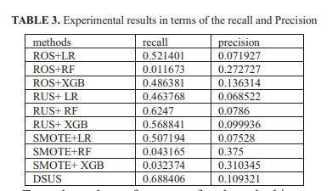
k samples yielding the largest SM values from both majority and minority class are selected separately for training the RBFNN
End while
Results:
A ten-fold stratified cross validation is implemented to record the performance of each method.
The DSUS captures the distribution to improve the diversity of resampling by clustering. Experimental results show the supreme performance of the DSUS compared to other three resampling methods and three classifiers.
Prediction Percentage is 88.1%
Conclusion:
In this study, we have improved loan default prediction by using the hybrid undersampling method DSUS which combines a k-means clustering method, a stochastic sensitivity measure and a robust RBFNN
Limitations:
We proved the DSUS preserving the distribution of information by clustering is significantly effective, but clustering methods in this approach is k-means, which would lead to unsatisfactory performance. Therefore, in future, we are planning to extend our study to verify the effectiveness of DSUS with other clustering mechanisms

